Slide 1
Machine learning fitting the phase function of tissues
Yuxuan Liang

Slide 2
Outline
Background and proposal
Scheme design and implement
Results and further plans

Slide 3
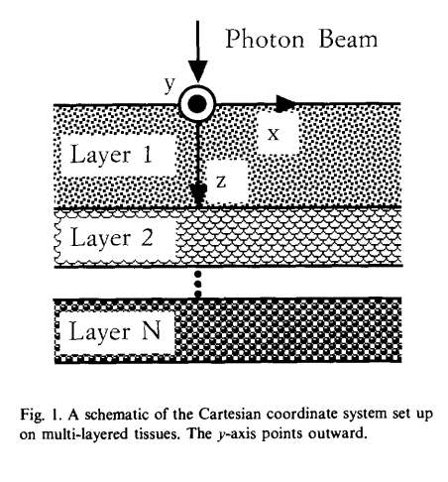
Background: Monte Carlo modeling of light transport in multi-layered tissues(MCML)
This model deals with the transportation of an infinitely narrow photon beam, perpendicularly incident on a multi-layered tissue.
Photons’ interaction with the tissue can be mainly described as absorption, scattering and deflection.
The light intensity distribution is detected at the surface of the tissue.
Lihong Wang, et al., Computer Methods and Programs in Biomedicine, 47: 131-146, 1995

Slide 4
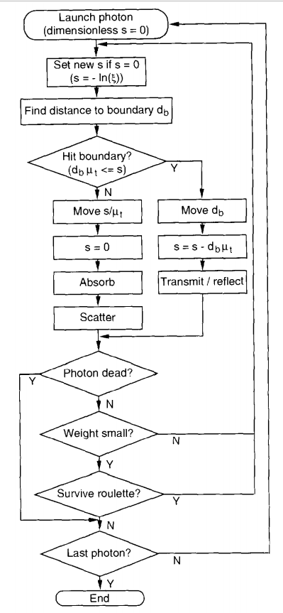
Simulating procedure
Photon launching
Step size
Photon moving
Photon absorption
Photon scattering
Photon hitting a boundary
Photon termination

Slide 5
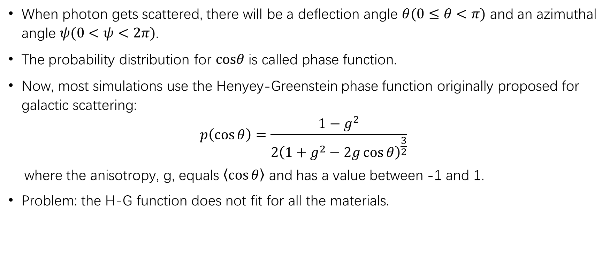
Photon scattering
When photon gets scattered, there will be a deflection angle $θ(0≤θ<π)$ and an azimuthal angle $ψ(0<ψ<2π)$.
The probability distribution for $cosθ$ is called phase function.
Now, most simulations use the Henyey-Greenstein phase function originally proposed for galactic scattering:
$$p\left(\cos{θ}\right)=\frac{1−g^{2}}{2{\left(1+g^{2}−2g\cos{θ}\right)}^{\frac{3}{2}}}$$
where the anisotropy, g, equals $\left\langle \cos{θ}\right\rangle$ and has a value between -1 and 1.
Problem: the H-G function does not fit for all the materials.

Slide 6
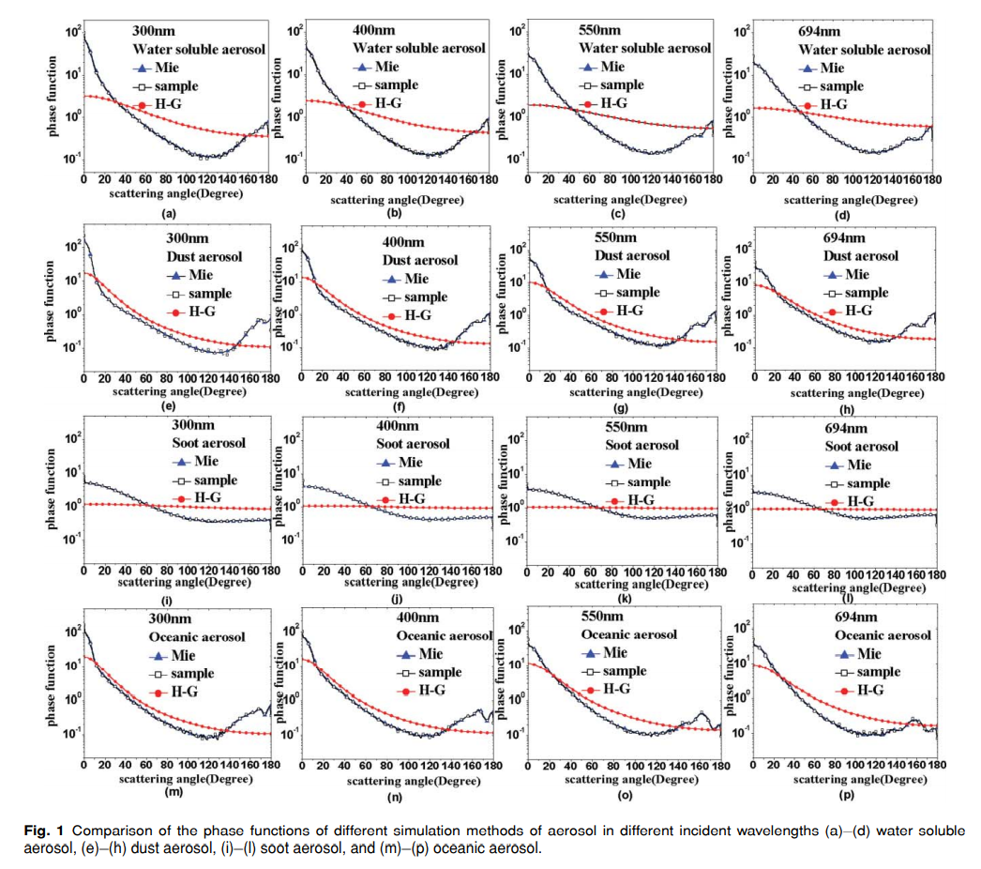
Study on phase function in Monte Carlo transmission characteristics of poly-disperse aerosol
Lu Bai, et al., Optical Engineering 50(1), 016002, 2011

Slide 7
Proposal
Although H-G function is widely used in MCML, it doesn’t fit for all kinds of materials.
Can we use the machine learning method to find a better model to fit the real phase functions of tissues?

Slide 8
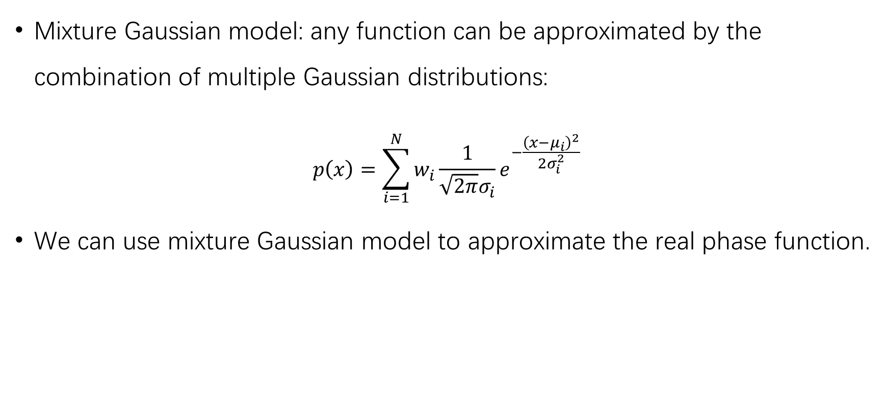
Mixture Gaussian model: any function can be approximated by the combination of multiple Gaussian distributions:
$$p\left(x\right)=\sum_{i=1}^{N}{w_{i}\frac{1}{\sqrt{2π}σ_{i}}e^{−\frac{{\left(x−μ_{i}\right)}^{2}}{2σ_{i}^{2}}}}$$
We can use mixture Gaussian model to approximate the real phase function.

Slide 9
Scheme design
Use MOSE toolkit to generate light intensity distribution images. While simulating, we can still use H-G function.
Use a neural network to learn the phase function. The input is the reflectance images obtained in MOSE, and the output is the weights and variances of those Gaussian distributions.
Perturb the phase function in simulation to test the generalization ability of the network.
Shenghan Ren, et al., PLoS ONE, 8(4):e61304, 2013.

Slide 10
Phantom Design
y
x
z
Incident light
Phantom: Single layer homogenous tissue
Size: 10mm x 10mm x 2mm (x, y, z)
Resolution: 0.02mm x 0.02mm x 0.1mm (x, y, z)
Top and bottom view transmittance image size: 500 x 500 pixels

Slide 11
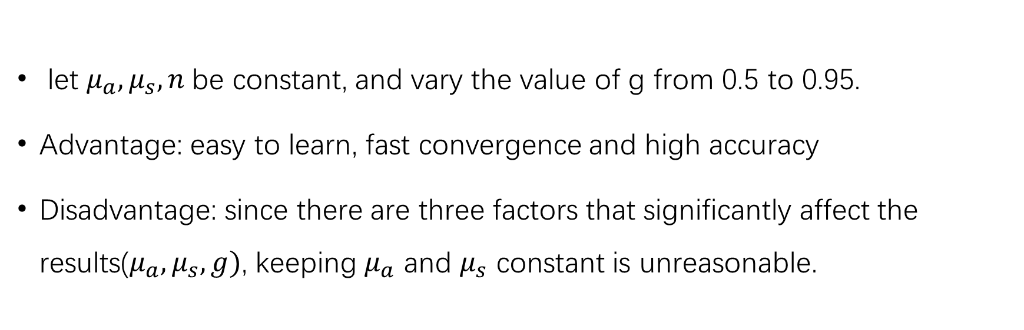
Dataset V1
let $μ_{a},μ_{s},n$be constant, and vary the value of g from 0.5 to 0.95.
Advantage: easy to learn, fast convergence and high accuracy
Disadvantage: since there are three factors that significantly affect the results($μ_{a},μ_{s}, g)$, keeping $μ_{a}$ and $μ_{s}$ constant is unreasonable.

Slide 12
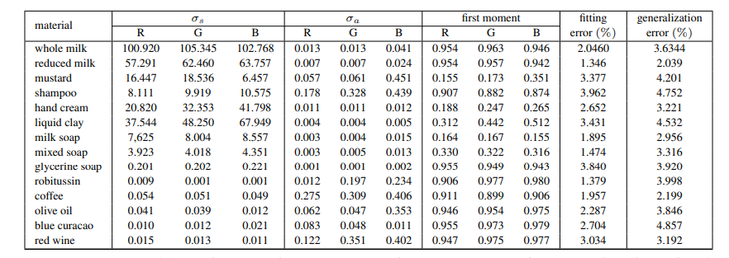
Dataset V2: based on real material parameters
Ioannis Gkioulekas, Inverse Volume Rendering with Material Dictionaries, ACM Transactions on Graphics, Volume 32, Issue 6 (2013)

Slide 13
Dataset V3: parameters vary in large ranges
Training and validation dataset
𝜇𝑎: [0.001, 0.05, 0.1, 0.5, 1, 2, 5, 10], 8 values
𝜇𝑠 : [0.01, 0.05, 0.1, 0.5, 1, 5, 10, 50, 100], 9 values
g : [-1:0.1:1], 21 values
1512 groups of parameters in total
For each group: 80 images for training, 20 for validation
Testing dataset
𝜇𝑎: [0.02, 0.08, 0.3, 0.8, 3, 6, 7.5, 9], 8 values
𝜇𝑠 : [0.03, 0.08, 0.3, 0.8, 3, 6, 20, 60, 80], 9 values
g : [-0.95:0.1:0.95], 20 values
1512 groups of parameters in total
For each group: 10 images

Slide 14
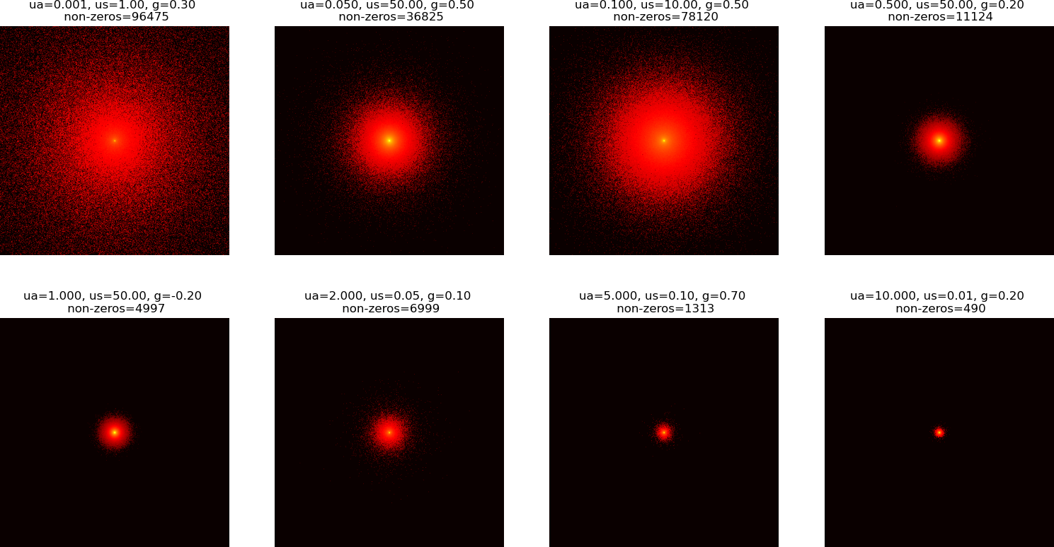
Dataset V3: Example images
For visualization, the dynamic range of the images are compressed to the 0.01 power of the original.

Slide 15
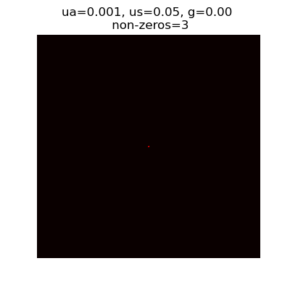
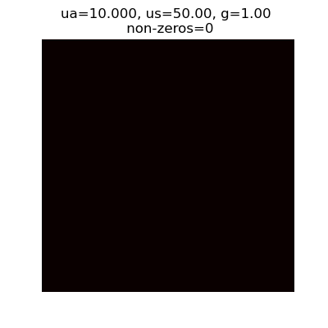
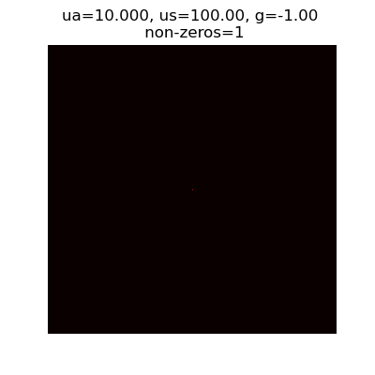
Dataset V3: Extreme images
Extreme small ua
g=1
g=-1
Some extreme parameter values, such extreme small ua, g=1 and g=-1, produce images with very few non-zero pixels. These images do provide information about the material properties, but they do not provide enough information for CNN to learn. These images are excluded from the dataset.

Slide 16
Dataset V3: Train and validation dataset
V3 | Parameter | Values | #Values | Training image number | Validation image number
Original | ua | 0.001, 0.05, 0.1, 0.5, 1, 2, 5, 10 | 8 | 1512 parameter sets, 80 per parameter set, 120960 in total | 1512 parameter sets, 20 per parameter set, 30240 in total
 | us | 0.01, 0.05, 0.1, 0.5, 1, 5, 10, 50, 100 | 9
 | g | -1:0.1:1 | 21
Extreme excluded | ua | 0.001, 0.05, 0.1, 0.5, 1, 2, 5, 10 | 8 | 1292 parameter sets, 80 per parameter set, 103360 in total | 1292 parameter sets, 20 per parameter set, 25840 in total
 | us | 0.01, 0.05, 0.1, 0.5, 1, 5, 10, 50, 100 | 9
 | g | -0.9:0.1:0.9 | 19
Half | Same as extreme excluded |  |  | 1292 parameter sets, 40 per parameter set, 51680 in total | 1292 parameter sets, 10 per parameter set, 12920 in total
The half datasets are used in the following experiment to save time

Slide 17
Dataset V3: Test dataset
V3 | Parameter | Values | #Values | Image number
Original | ua | 0.02, 0.08, 0.3, 0.8, 3, 6, 7.5, 9 | 8 | 1440 parameter sets, 10 per parameter set, 14400 in total
 | us | 0.03, 0.08, 0.3, 0.8, 3, 6, 20, 60, 80 | 9
 | g | -0.95:0.1:0.95 | 20
Extreme excluded | ua | 0.02, 0.08, 0.3, 0.8, 3, 6, 7.5, 9 | 8 | 1400 parameter sets, 10 per parameter set, 14000 in total
 | us | 0.03, 0.08, 0.3, 0.8, 3, 6, 20, 60, 80 | 9
 | g | -0.95:0.1:0.95 | 20

Slide 18


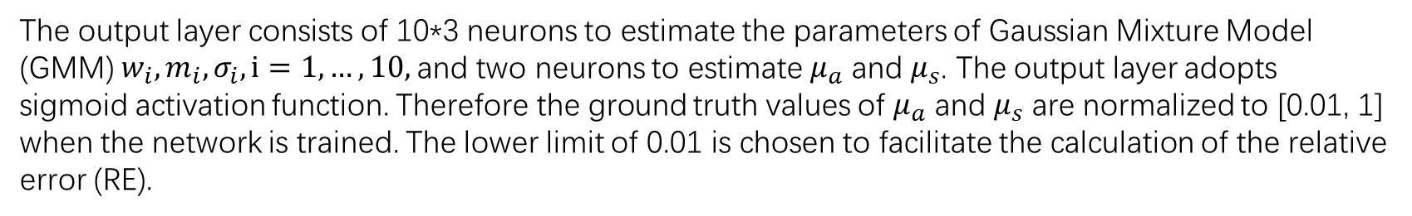

Network Structure: 6 convolution layers, 1 fc layer
conv1
…
10*3 ($w_{i},m_{i},σ_{i})$
conv2
conv3
conv4
conv5
conv6
…
$$μ_{a}$$
$$μ_{s}$$
3*3*32
3*3*32
3*3*64
3*3*64
3*3*128
3*3*128
128*11*11
for input size
500x500
The output layer consists of 10*3 neurons to estimate the parameters of Gaussian Mixture Model (GMM) $w_{i},m_{i},σ_{i}, i=1,…,10,$and two neurons to estimate $μ_{a}$ and $μ_{s}$. The output layer adopts sigmoid activation function. Therefore the ground truth values of $μ_{a}$ and $μ_{s}$ are normalized to [0.01, 1] when the network is trained. The lower limit of 0.01 is chosen to facilitate the calculation of the relative error (RE).

Slide 19
Implement details
Loss function: loss = loss_phase + loss_uas
loss_phase is defined as the mean squared error (MSE) between the GMM fitted phase function and H-G function. The GMM estimation is rescaled to guarantee it integrates to 1 over [0, pi].
loss_uas is the MSE of ua and us.
GPU: Titan Xp
Dependency: Pytorch 1.8.1
Optimizer: Adam
Initial learning rate: 5e-4, decreased by a factor of 0.1 every 10 epochs
Weight decay: 5e-3
Batch size: 60

Slide 20
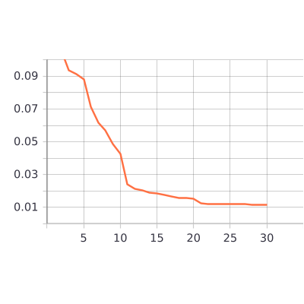
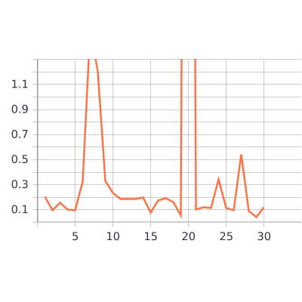
Results – Training process
Train loss
Validation loss
The training process is convergent, but the large fluctuations in the validation error suggest that that the network shows signs of overfitting.

Slide 21
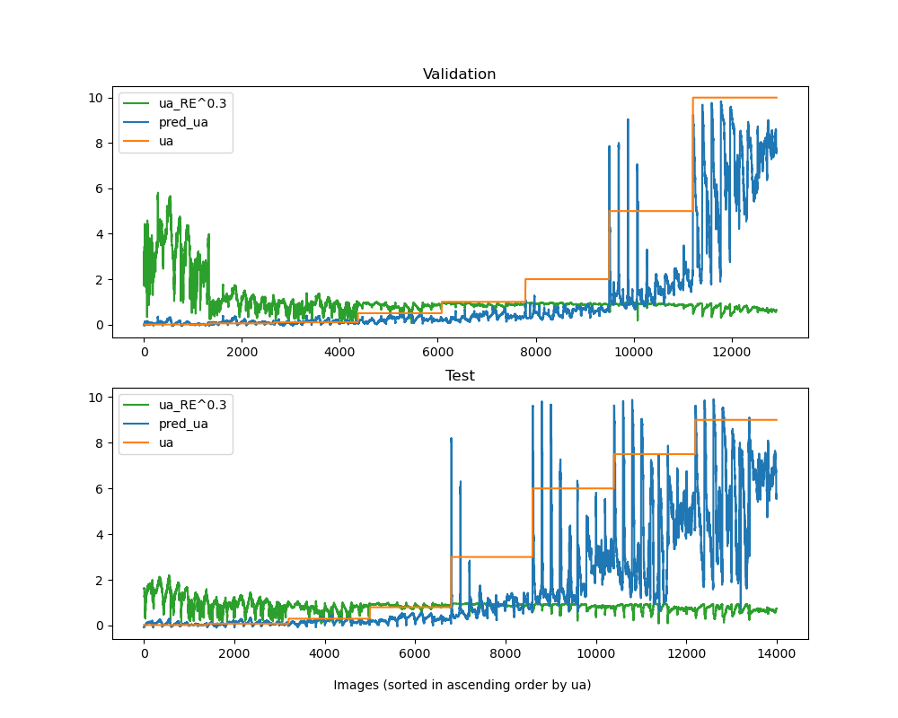
Results – ua estimation
Validation
The relative error is large when ua is small and gets smaller when ua gets larger.
Test
The overall trend is the same as the validation, but when ua is small, the relative error of test is smaller than that of validation.

Slide 22
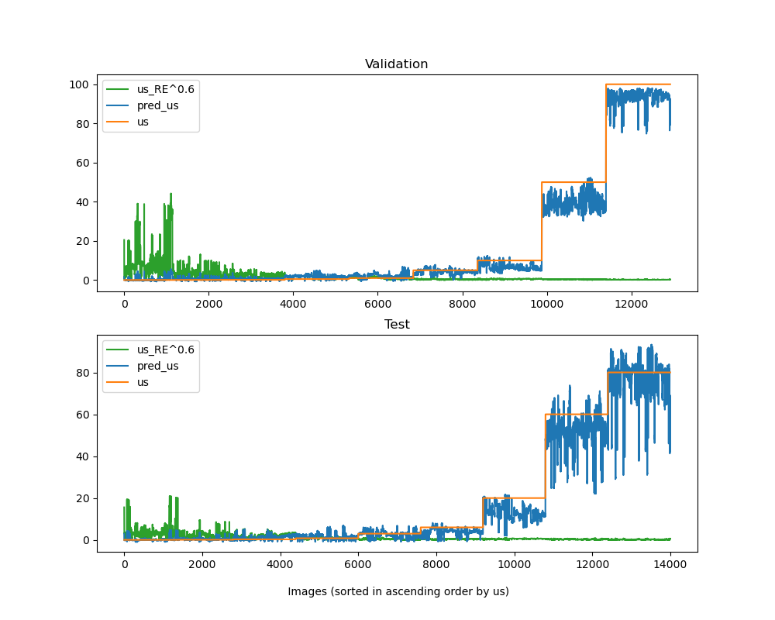
Results – us estimation
The overall trend is the same as the ua estimation. The relative error is large when us is small and gets smaller when us gets larger. When us is small, the relative error of test is smaller than that of validation.
Over all, the relative error of us estimation is smaller that ua.

Slide 23
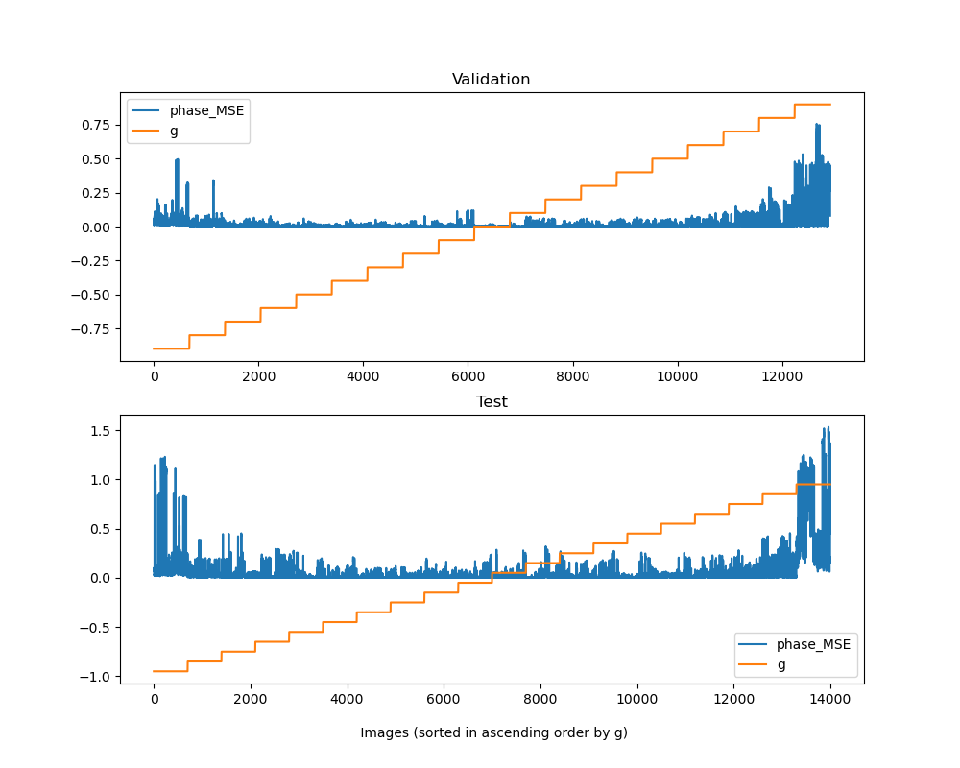
Results – phase function estimation
Validation
The MSE loss gets bigger when g approaches the boundary value (1 or -1).
Test
The trend is the same as validation, but the overall value of relative error is bigger, which means the network might be over-fitting.

Slide 24
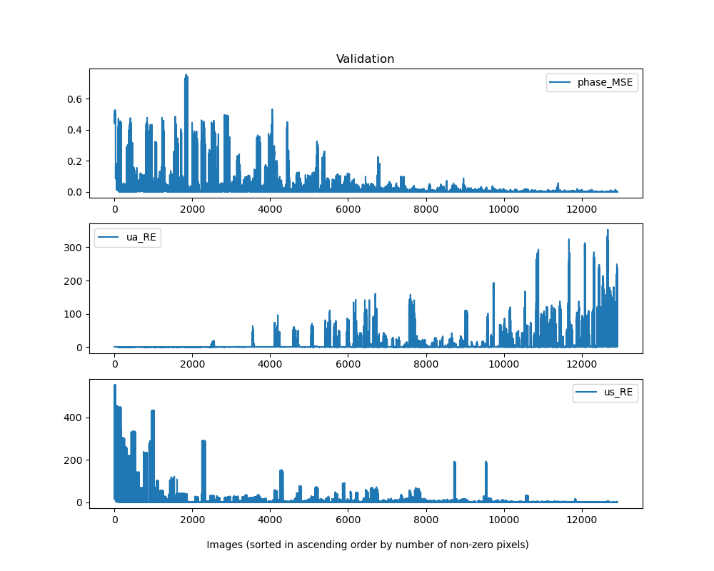
Results – factor correlation
Number of none-zero pixels increases

Slide 25
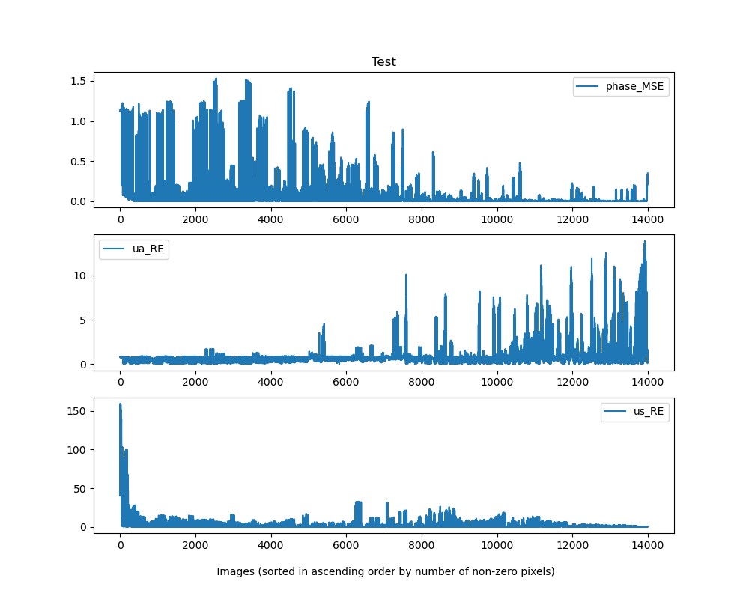
Results – factor correlation
The results of validation and test have similar factors. With the number of none-zero pixels increasing, the MSE loss of the phase function and the relative error of us decrease, while the relative error of ua increase.
Number of none-zero pixels increases

Slide 26
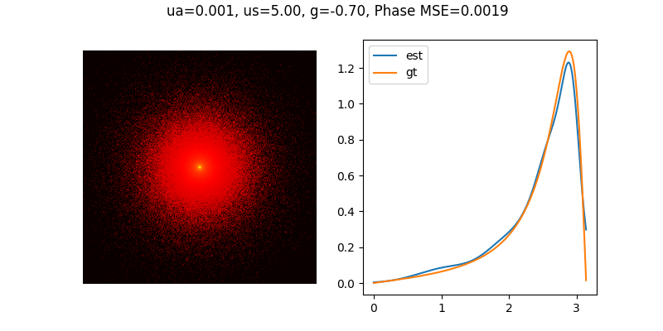
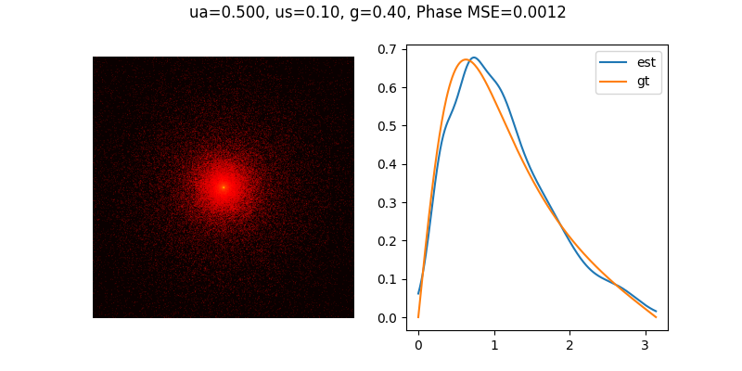
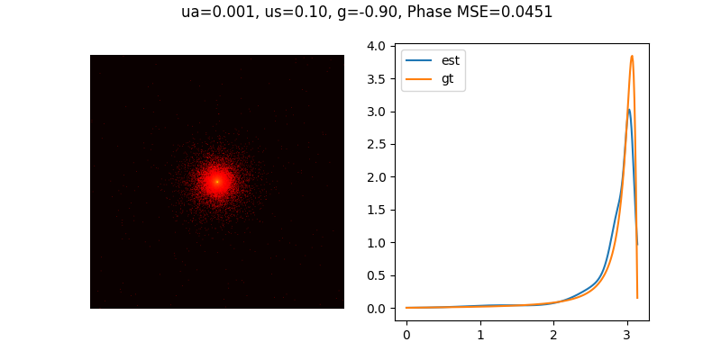
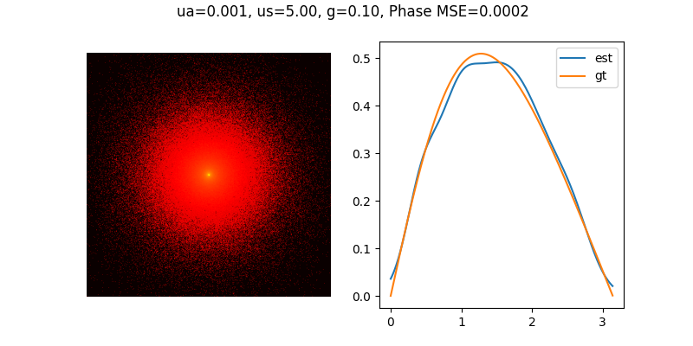
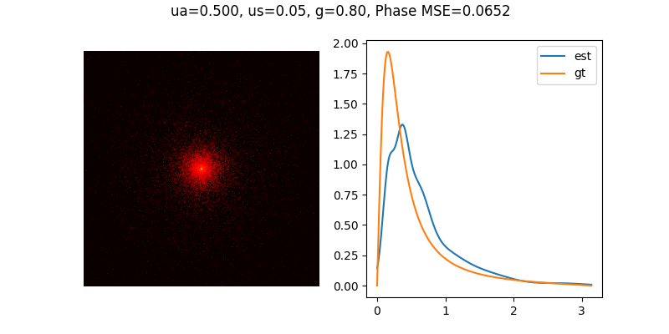
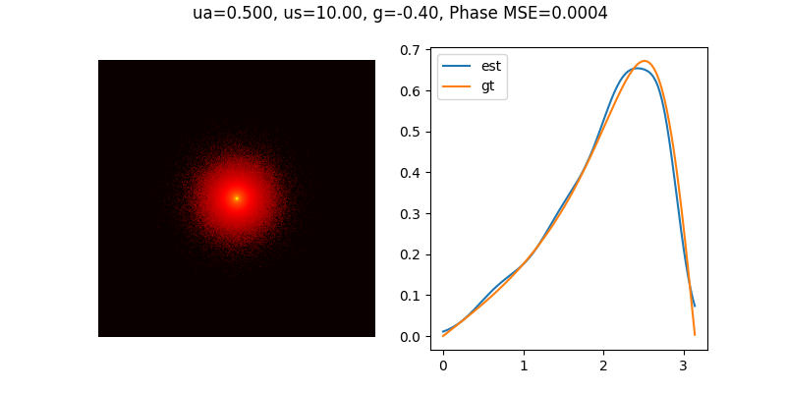
Results – Samples of validation

Slide 27
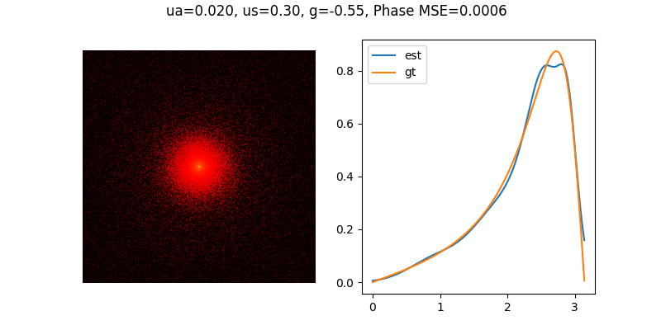
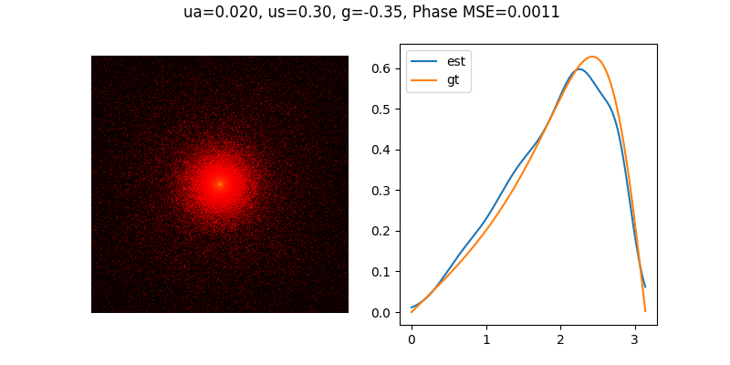
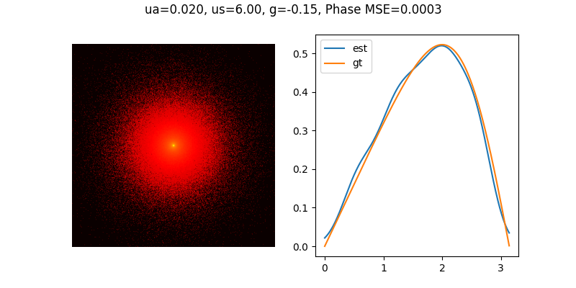
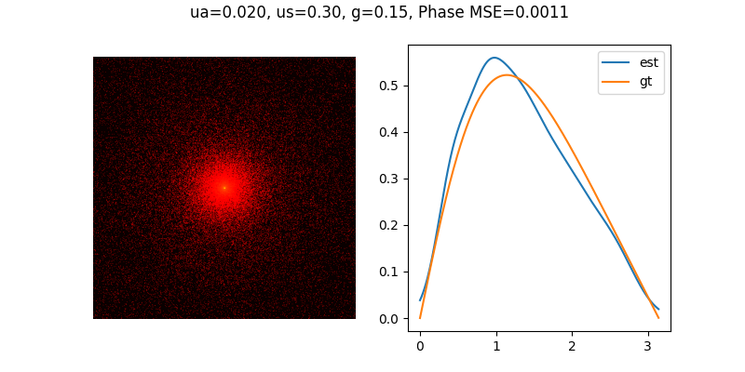
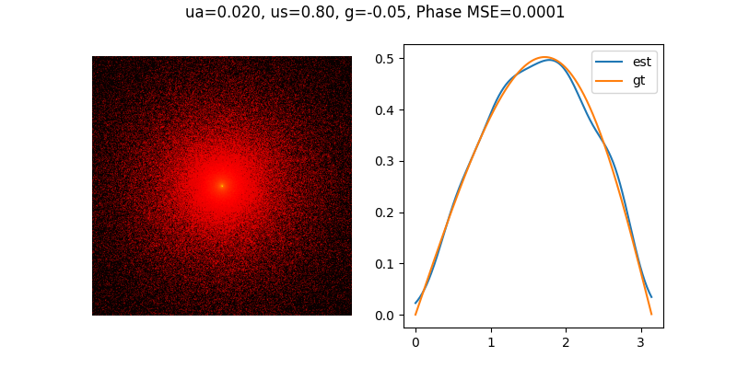
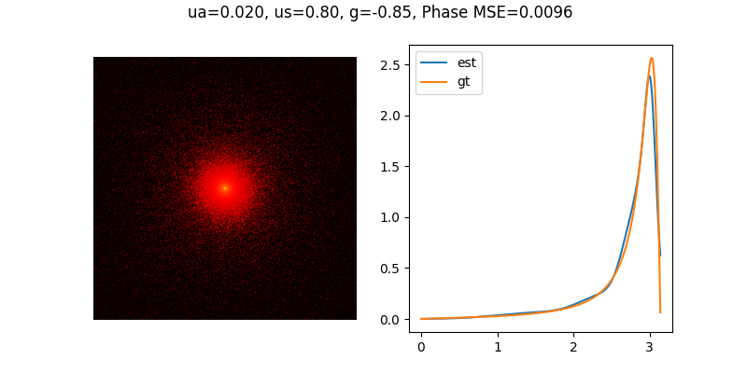
Results – Samples of test

Slide 28
Summary
On the whole, the fitting effect of the network is good, but the error may increase when the number of none-zero pixels is small. The reason might be when the number of none-zero pixels is small, there are few image features to learn.
The network is a bit over-fitting, perhaps because the number of inputs of the fully connected layer is too big (128*11*11).
The accuracy of ua and us estimation is not enough.

Slide 29
Discussion
Why is the relative error of test smaller than that of validation?
What factors affect the accuracy of parameter and phase function estimation(number of none-zero pixels seems to be one for phase function and us, but not for ua)?
Is the phase function estimation precise enough? If not, how to improve the accuracy?

Slide 30




Further plan
Change the network into the following form:
…
$$μ_{a}$$
Global pooling
conv1
conv2
conv3
conv4
conv5
conv6
…
$$μ_{s}$$
$$μ_{a}$$
3*3*32
3*3*32
3*3*64
3*3*64
3*3*128
3*3*128
…
…
10*3 ($w_{i},m_{i},σ_{i})$
128*1*1
for input size
500x500

Slide 31
Thanks for listening!

